Slide 1
0. Contents
1. Event sourcing
2. Questions
3. Current Status
4. A few problems
5. Architecture
6. Talk is cheap
7. Benefits
8. Chanllenges
9. When to use

Slide 2
1. Event Sourcing
It is the practice of modelling your system as a
sequence of events
martinfowler about event sourcing

Slide 3
2. Questions
Do you have developed or used some system using
this approach?

Slide 4
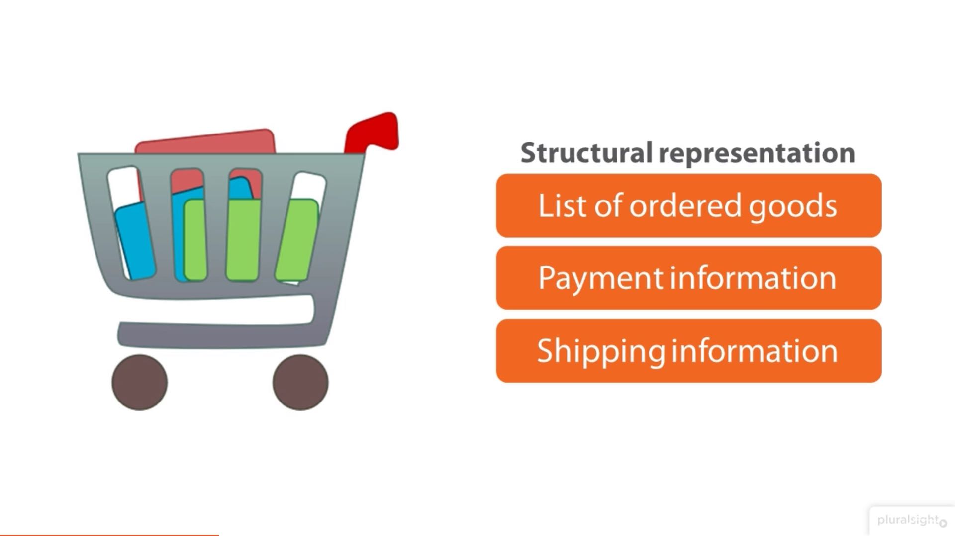
3.

Slide 5
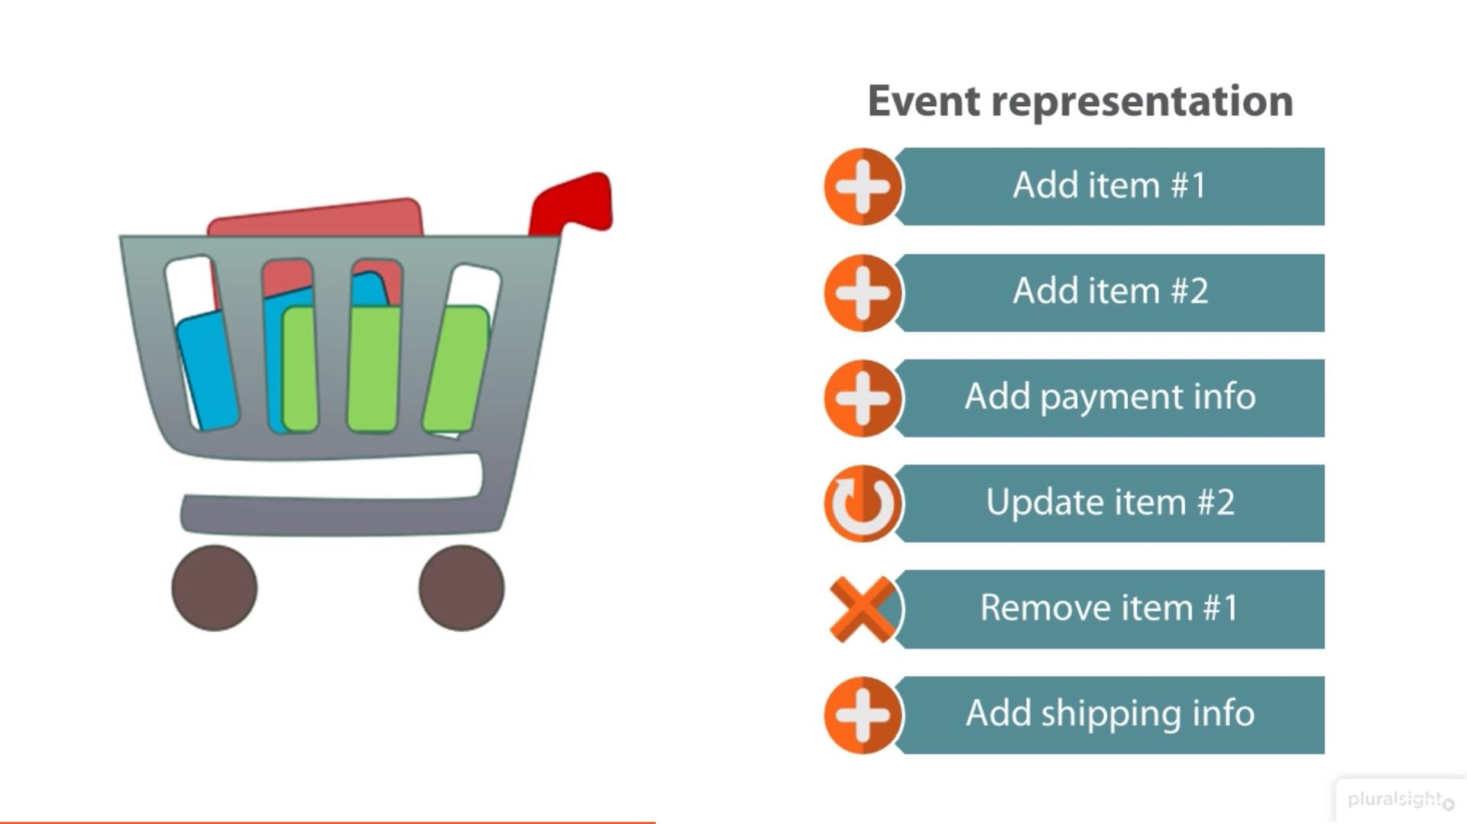

Slide 6
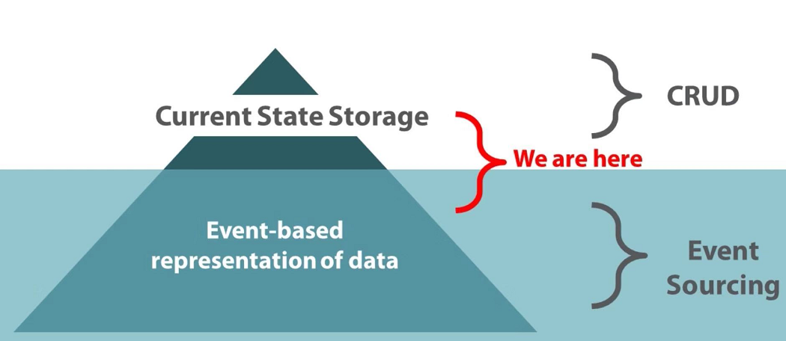
3. Current Status
Notes:
event sourcing is not how the vast majority of applications work today
most applications work by storing the current state and use stored state to process business transactions

Slide 7
4. A few problems to think
1."How many times has a user changed their email address" could you answer it?
2. "How many people added an item to their cart, then removed it, then bought that item a month later"?

Slide 8
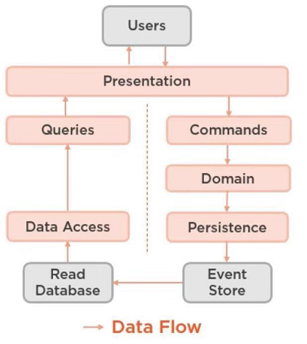
5. Architecture

Slide 9
6. Talk is cheap
Talk is cheap, show me the code

Slide 10
7. Benefits
1. Audit trail
2. Debugging
3. Historic state
4. Variant schemas
5. Distribution support

Slide 11
8. Chanllenges
1.change of mindset for developing
2.change of event structure needs a few ways to handle
3.learning curve based on domain model not database table

Slide 12
9. When to use
1.simple crud not suitable
2.complex business
3.team has members familiar with ddd
4.system care about history version
5.analise behavior

Slide 13
Thanks！

